Slide 1

Welcome to
Year 1!
Show respect
Be determined
Make good choices
Be the best you can be!
Use kind words
Have a go!

Slide 2
Year 1
Year Leader: Mrs Todd
Y1T (Dragonfly Class) Mrs Todd
Y1M (Firefly Class) Miss Martin
Y1HC (Butterfly Class) Mrs Hogan and Mrs Cufley
Teaching Assistants: Mrs Neely, Mrs Bedford, Mrs Hinton, Mrs Dunn and Mrs Hawkins.

Slide 3
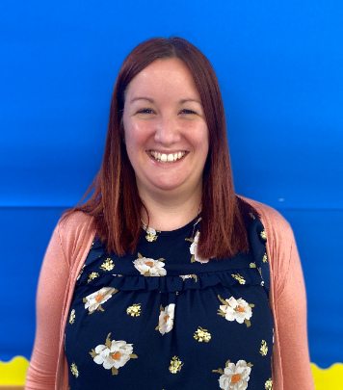
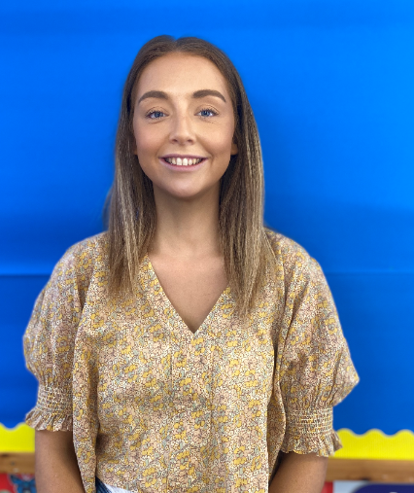
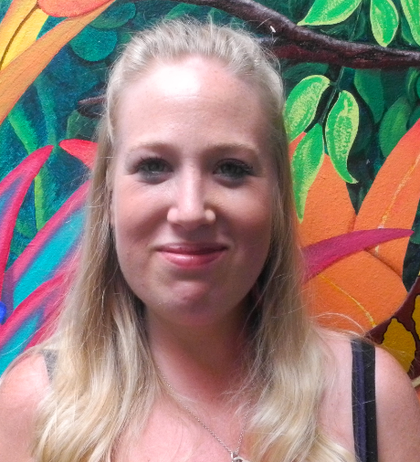
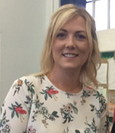
Who are we?
Dragonfly Class:
Mrs Todd
(Year leader):
Firefly Class:
Miss Martin
Butterfly Class:
Mrs Cufley
Butterfly Class:
Mrs Hogan

Slide 4
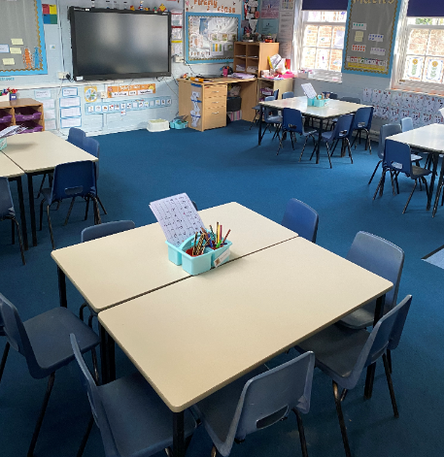
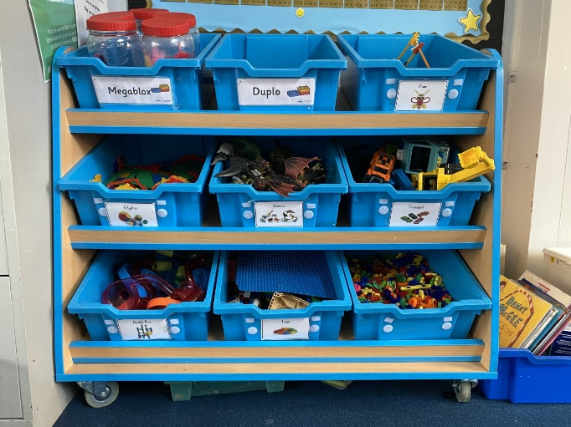
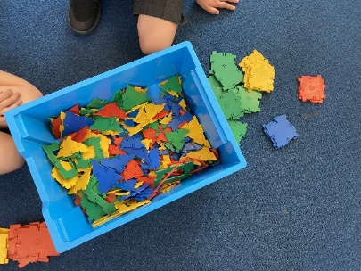
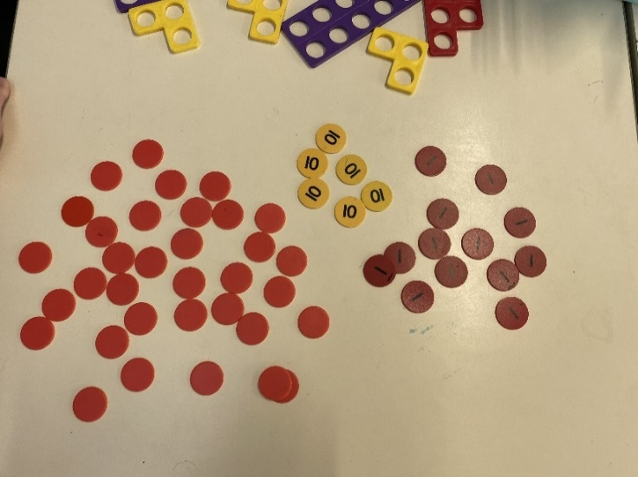
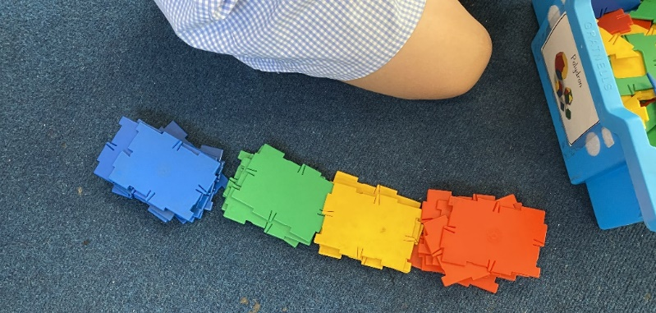
Inside a Year 1 Classroom

Slide 5
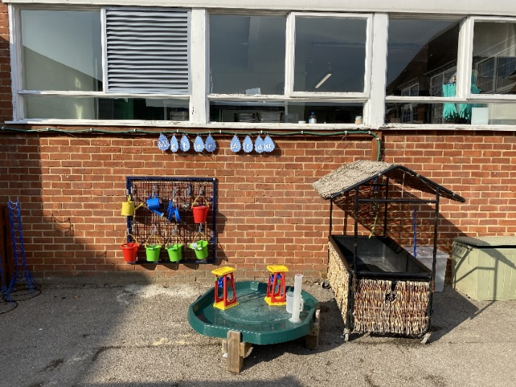
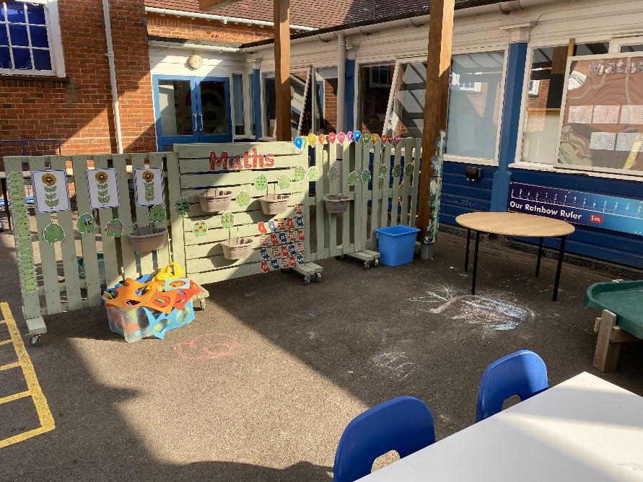
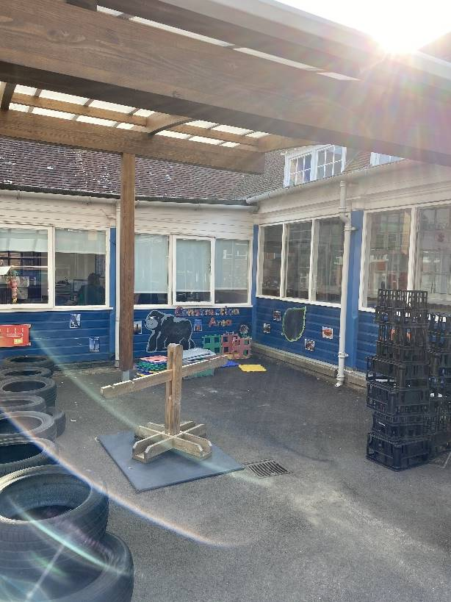
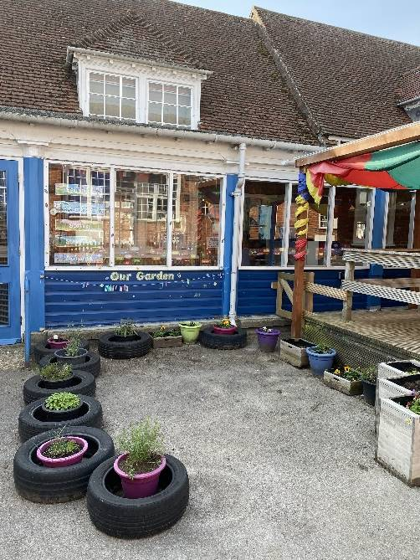
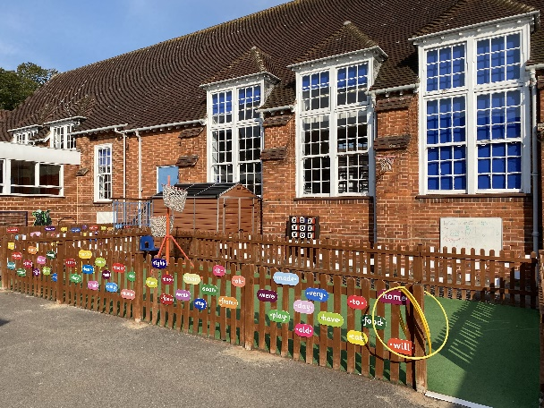
We still have outdoor learning too!
Challenge yourself

Slide 6
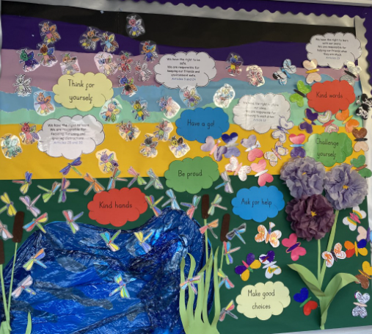
Our year group mission statement

Slide 7
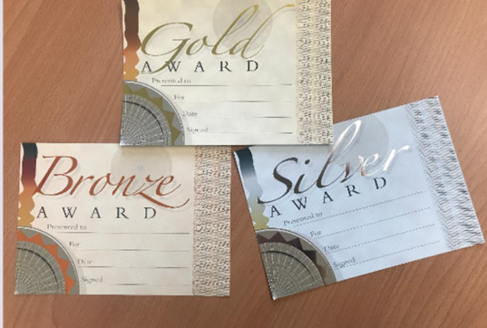
Rewards - Merit point system
At Harrison we award merit points for positive learning behaviour falling into the 4 strands of Citizenship, Attitude to learning, Responsibility and Excellence. Children collect merit points on their merit card to work towards their bronze, silver, gold, platinum and head teacher’s award certificates.

Slide 8
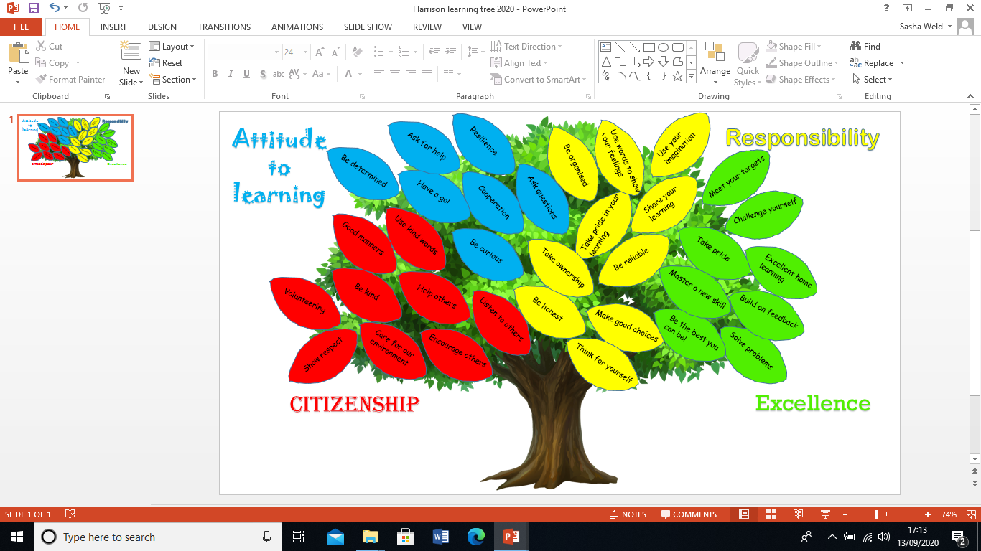

Slide 9

Reading in school
In Year 1, children will begin to take part in paired reading where they will read aloud to a partner and listen to a partner read to them. Teachers will listen to every child read each week.
Children move up book bands when they are able to read most words in books of that level but also have a good understanding of what they have read. We will also continue to work on word sets with children.

Slide 10



Writing in school
Children will write various pieces of fiction and non-fiction throughout the year. All writing will be inspired by a high-quality text and we give children plenty of opportunities to develop their ideas through drama, role play and visitors to the school.

Slide 11

Writing in school
We follow Kinetic Letters as our handwriting scheme. Children have previously learnt many of the letter and number formations in Year R and we will continue to build on their previous learning. We will be sending Kinetic Letter handwriting packs home so that you are able to practise at home with your child.
To complement our teaching in school please initially practise the letters from the ‘Jumper Family’. We will send a text to notify you of when we move onto the next letter family.
In addition, we have videos on our Harrison YouTube channel which show Mrs Todd and Miss Weld demonstrating how to write the letters.
https://www.youtube.com/playlist?list=PLC5BKBCYFWpt2i3U9wE2kxPKi0qtL0QUJ
Take pride

Slide 12
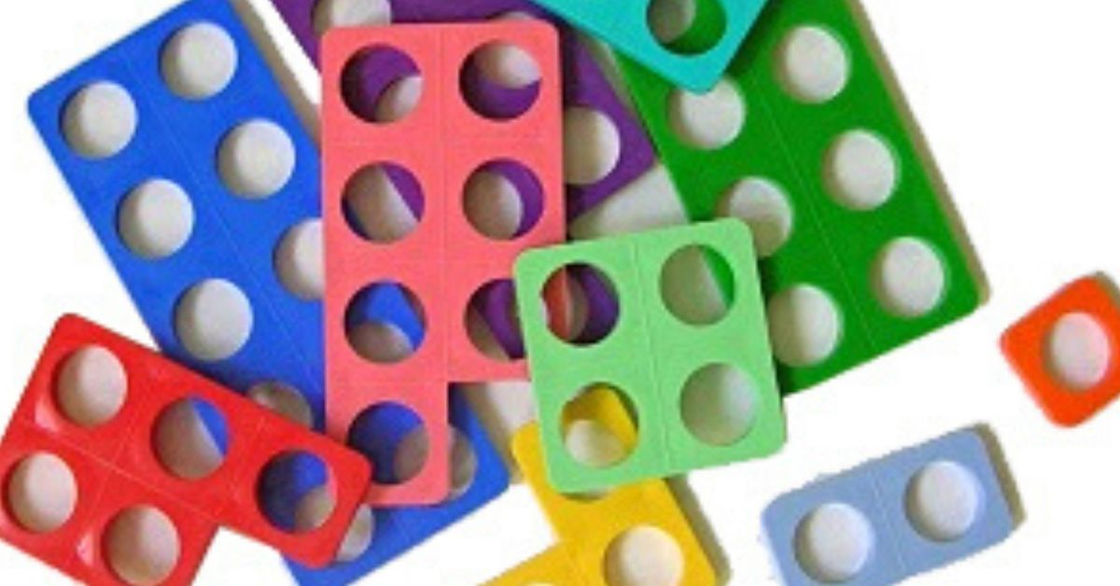
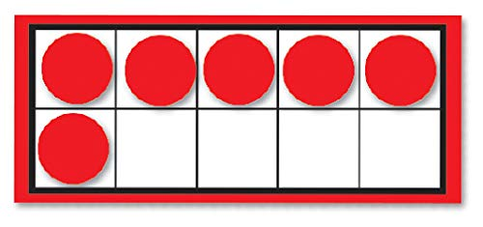
Maths in school
We follow the White Rose Maths scheme and will begin by ensuring children are confident with the skills from the Early Years Foundation Stage. We use lots of resources to help with our learning such as diennes, tens frames and Numicon.
As well as Maths lessons, we have a daily mental maths session so children are able to consolidate skills they have learnt.

Slide 13
Foundation Curriculum
We will continue to teach children a range of subjects at school. Our year group newsletter will detail the topics that we cover each term.
Lots of our foundation curriculum learning will take place in outside areas so please ensure that your child has a clipboard and a coat.
We will still have visits and visitors to the school to inspire children’s learning and deepen their knowledge.

Slide 14

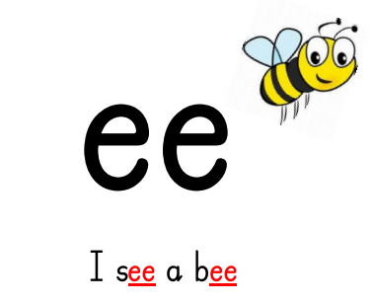
Phonics
We continue to follow the Letters and Sounds program that the children started in Reception.
We will be working on phases 3, 4 and 5.
Taught everyday for 20 minutes.

Slide 15
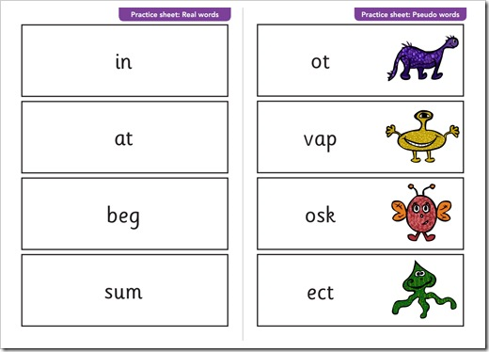
Y1 Phonics Screening check
In June 2021 the national check will take place in schools across the country for all children age 5/6.
The Phonics Screen Check assesses your child’s ability to decode against age related expectations.
They will be expected to apply their phonics knowledge to real and nonsense words.

Slide 16
Home learning
We want to make sure that every child in Year 1 becomes a fluent, confident reader. In order to do this, they must have excellent knowledge of letter sounds; how to name, say, blend and write these.
You can help by reading a range of texts with your child at least four times each week. Please record when you read with your child in their reading diary. We will be sending home an additional leaflet which will provide you with some prompts you can use to support the development of your child’s comprehension skills.
Your child will be awarded a yellow responsibility merit point weekly for having at least four reads recorded in their reading diaries.
Be reliable
Take ownership

Slide 17

Where can I get more books?
Please find your child’s log in details in the front cover of their reading diary.
Once you have logged in you will be able to access books that are appropriate to your child’s level.

Slide 18

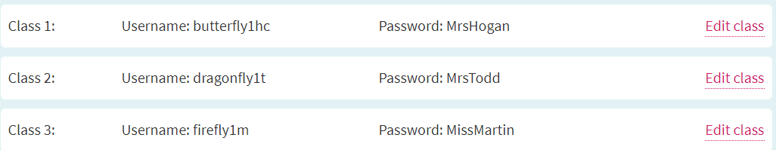
Where can I get more books?
In addition to using Bug Club, you can access a range of e-books using Oxford Owl which can be found by following this link. https://www.oxfordowl.co.uk
In the top right hand corner of the screen there is an icon which says 'My class login'. Please enter the ​details provided below (these are case sensitive).

Slide 19
Break times
Healthy Eating
Free fruit is provided for children daily to have at break time but your child may want to bring one healthy snack from home.
Nut Allergies
Please note we have children with severe allergic reactions to nuts presently attending Harrison Primary School. We therefore ask all parents to ensure no nuts or nut products are included in lunch boxes or as break time snacks.
Water
Please ensure your child brings in a named bottle of water for use in the classroom.

Slide 20
Share your learning
Be organised
Take pride in your learning
Share your learning
Aim high
Cooperation
Master a new skill
Be kind
Encourage others
Challenge yourself
Ask questions
Care for our environment
Be a good friend
We are looking forward to a fabulous year!
Solve problems
Have a go!
Make good choices
Use your imagination
Be determined
Excellent home learning
Use kind words
Resilience
Take pride
Be curious

